Slide 1
DAY TRADING WITH PIVOT POINTS & PRICE ACTION
15th September (Sunday)
A Webinar by
Vikram
Full Time Trader & Trainer
Founder- pivotcall.com
pivotcall.com

Slide 2
Introduction
Hello …
Welcome you all to my webinar on Day Trading with “Pivot points & Price Action”
My name is Vikram, I am a self learned Trader, I have previously worked in Sales, Marketing, Business Development and Training profile for close to 2 decades.
I am also a founder of blog called pivotcall.com, which is a Trading educational blog.
I have been Trading since 2004 as a part timer, and quit my job in 2018 to become a full time Trader.
I am a Pattern Trader, I trade patterns and take directional trades based on price action and pivot points.
This course is designed based on my thousands hours of screen time, years of back testing and almost 15 years of experience in stock market.
pivotcall.com

Slide 3
WEBINAR CONTENTS
INTRODUCTION OF PIVOT POINTS & PRICE ACTION
Basics of pivot points, price action and powerful candle stick patterns in day trading
Important pivots and some secrets of pivot points in day trading
How to prepare your chart by marking important zones before market opening
How to use Trading view software to find pivot points and CPR.
MY 15 DAY TRADING PATTERNS AND MY STRATEGIES
Discussion of my 15 day trading patterns and it’s strategies with historical charts
My SL(stop loss) method in day trading
Secrets of using moving averages in day trading
How do I select option strikes for my day trading
Online Quiz –Guess the Pattern
pivotcall.com

Slide 4
WEBINAR CONTENTS
RISK MANAGEMNT & POSITION SIZING
Importance of Risk - Reward in each trade
Position sizing method in day trading.
5 rules of Risk management
How to prepare and maintain a trading journal
TRADING PSYCHOLOGY
Why trading psychology is most important in trading
Powerful methods to control emotions during trading.
7 reasons behind my Day Trading success
Q&A Session and wrap up
pivotcall.com

Slide 5

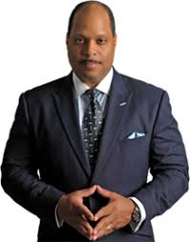
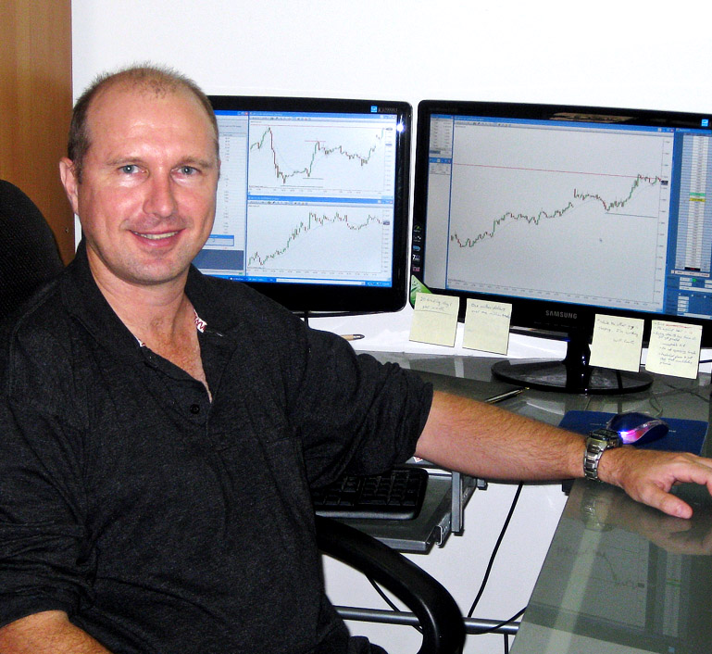
MY DAY TRDAING INSPIRATIONAL GURUS
FRANK OCHOA
pivotboss.com
OLIVER VELEZ
olivervelez.com
LANCE BEGGS
yourtradingcoach.com

Slide 6



One can Start with these three…

Slide 7
SESSION -1
INTRODUCTION OF PIVOT POINTS & PRICE ACTION

Slide 8
Why Pivot points are important in Day Trading
Pivot meaning – “Turn around or reverse”
Pivots are stagnant on chart, it is same for 5 min/15min/30 min or1 hour TF.
Pivots- Nothing but support/Resistance, calculated based on average price of high/low/close of previous day/week/month
Pivots will give mark boundaries on your line where price likely to have support/resistance which offers you frame work to trade on
Pivots-Purely derived by price….Pivots are pure leading indicator (not lagging indicators like MACD, RSI or Bollinger bands etc.)
Pivots – Used and Trusted by big players, institutes, professionals.
pivotcall.com

Slide 9
Basics and types of Pivot Points
Pivot point (PP) = (previous High + previous Low + previous Close) / 3
(R1) = (2 x PP) – Low
(S1) = (2 x PP) – High
(R2) = PP + (High – Low)
(S2) = PP – (High – Low)
(R3) = High + 2(PP – Low)
(S3) = Low – 2(High – PP)
Same calculation for daily/ weekly/monthly/yearly.
Formula for CPR (central pivot range)
Pivot= (High + Low+ Close)/3
BCPR=(High + Low)/2
TCPR = (Pivot – BCPR)+ Pivot
pivotcall.com

Slide 10
Secrets of Pivots in Day Trading
Some secrets of Pivot Points
Which is the most important or powerful pivot in Day Trading??
Answer - CPR (Central Pivot Range)….
Followed by Daily,Weekly,Monthly,Yearly
a) If weekly/monthly pivots near to CPR, then they are not much powerful, if weekly/monthly pivots are away from CPR then they are more powerful
b) As long as price is above CPR, it is generally known as bullish, and as long as it is below CPR known as bearish, (most often)
c)More wider the CPR, more difficult for price to penetrate, so wider CPR has more strength than narrow width CPR(most often)
pivotcall.com

Slide 11
Secrets of Pivots in Day Trading
d)If CPR is too narrow its easy for price to penetrate and narrow CPR has high rate of trending days(but not always).
e)Whenever CPR is wider, one can assume that such days could be range day(but not always) where price moves from one range to another throughout the day, so one can plan a strategy accordingly.
f)Virgin CPR is one of the most powerful CPR (most often),nearest virgin CPR is more powerful than CPR is farer.
Price respects previous virgin CPR at opening compared to mid to late afternoon.
g) In a strong uptrend/downtrend price stays above CPR/below CPR(Most of the time)
To learn more about Pivots, one can read “Secrets of Pivot Boss” by Frank Ochoa and “The Logical Trader” by Mark Fischer

Slide 12
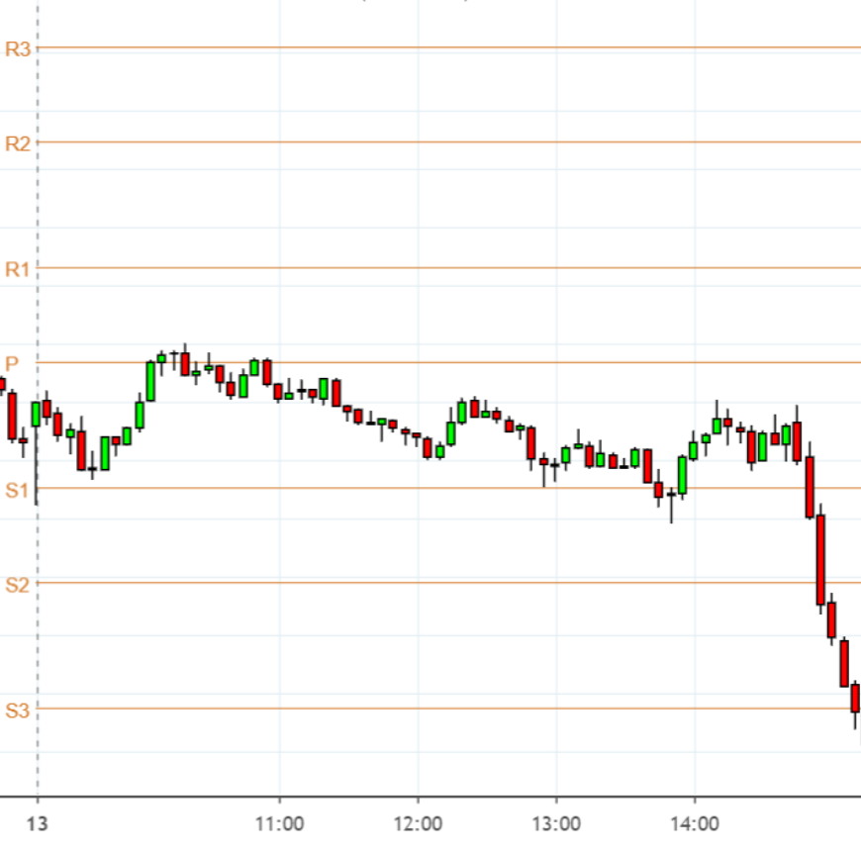
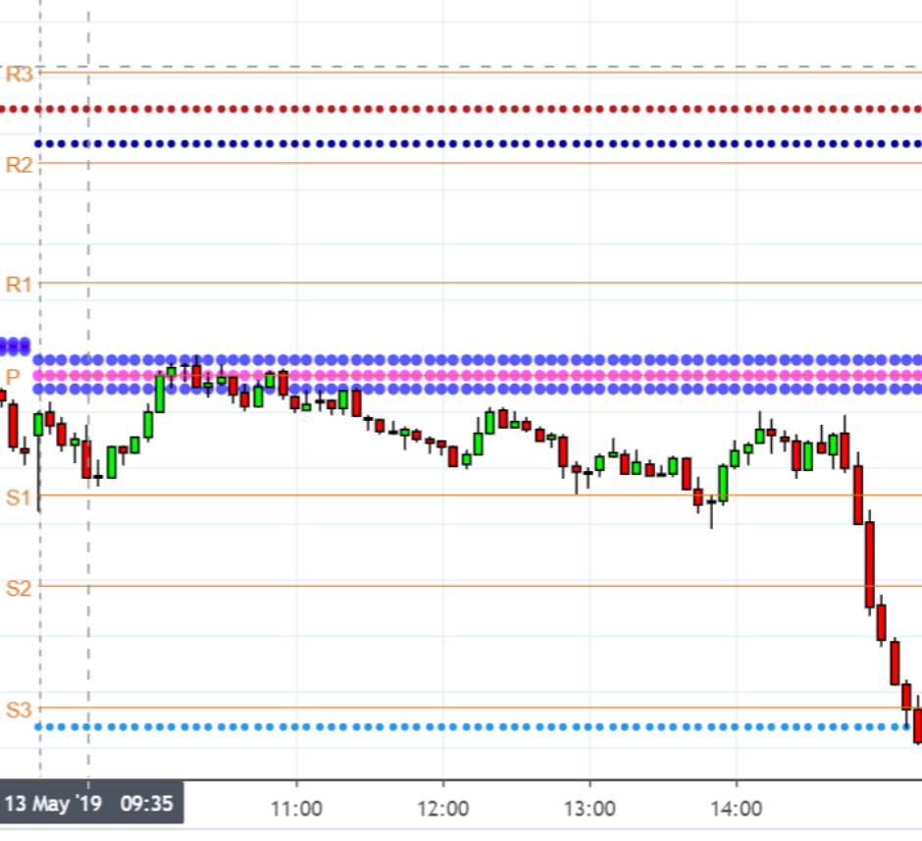
conventional pivots VS chart with multiple pivots
Conventional chart with pivots Chart with CPR & other pivots
pivotcall.com

Slide 13
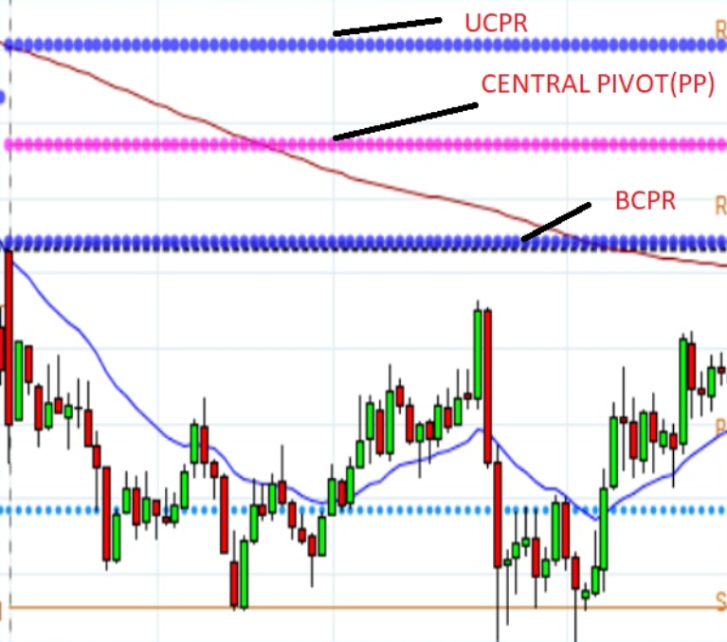
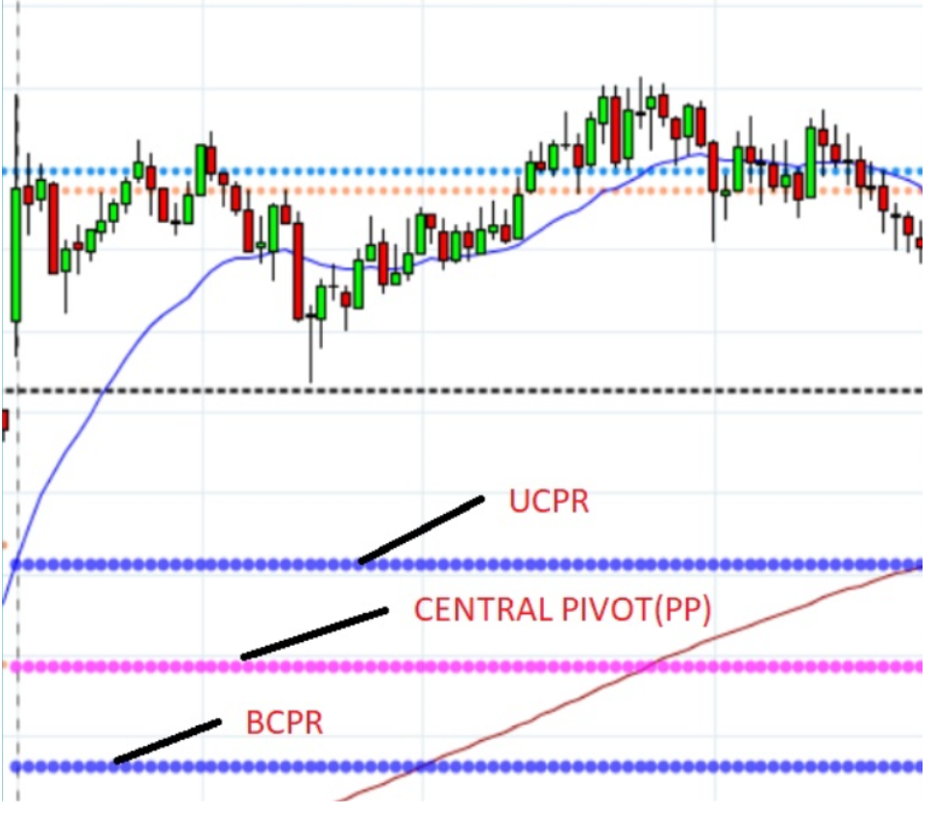
CPR on daily chart (with Virgin CPR)

Slide 14
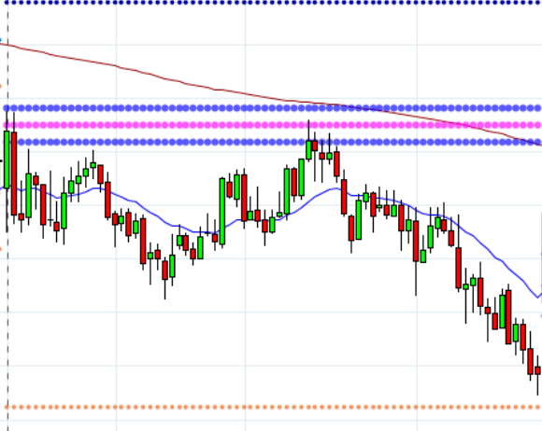
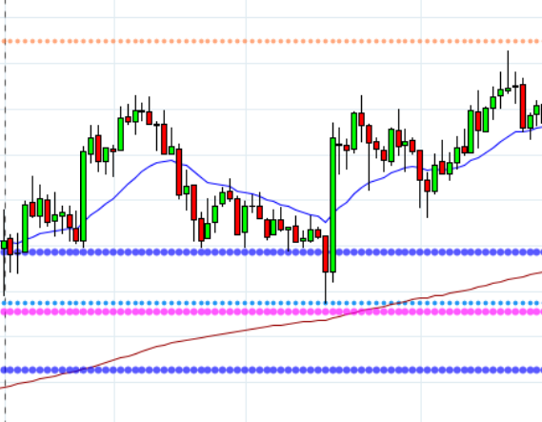
CPR on daily chart
pivotcall.com

Slide 15
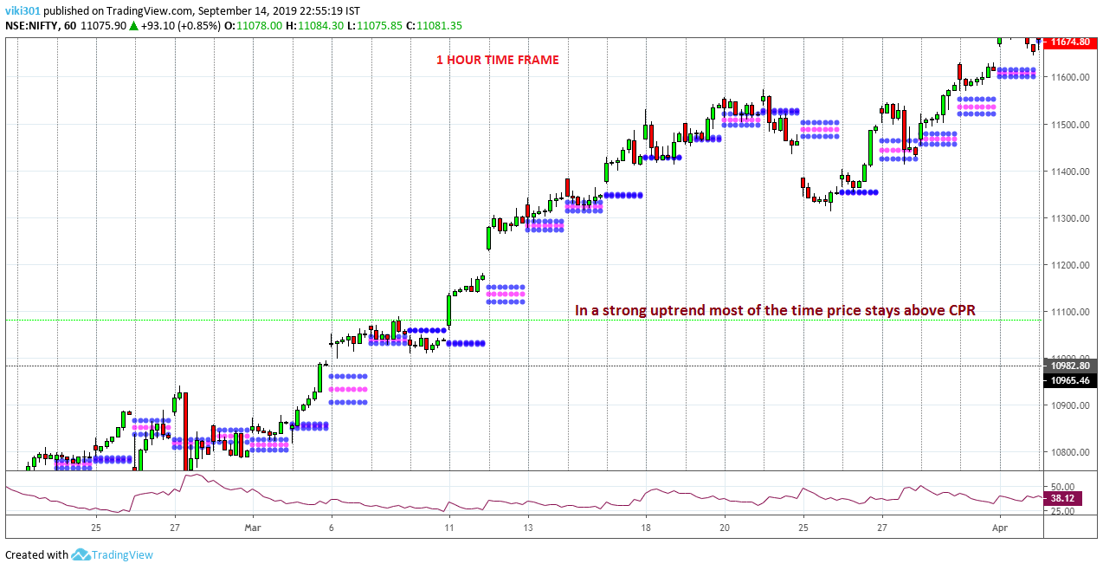
Price staying above CPR on uptrend (most of the time)

Slide 16
Basics of Price action
Price action is a method where a Trader makes a decision based on actual price action by candle by candle movement on the chart.
Trader assesses and takes the trade based on support and resistance and aggressiveness of buying and selling at those levels with candlestick patterns.
Decision to buy or sell is taken based on price behavior at important locations on the chart.
Price action trader is the one who trades without any lagging indicators like RSI/Bollinger bands/MACD/Stockastic etc. on his chart and analyze chart by just price movements.
pivotcall.com

Slide 17
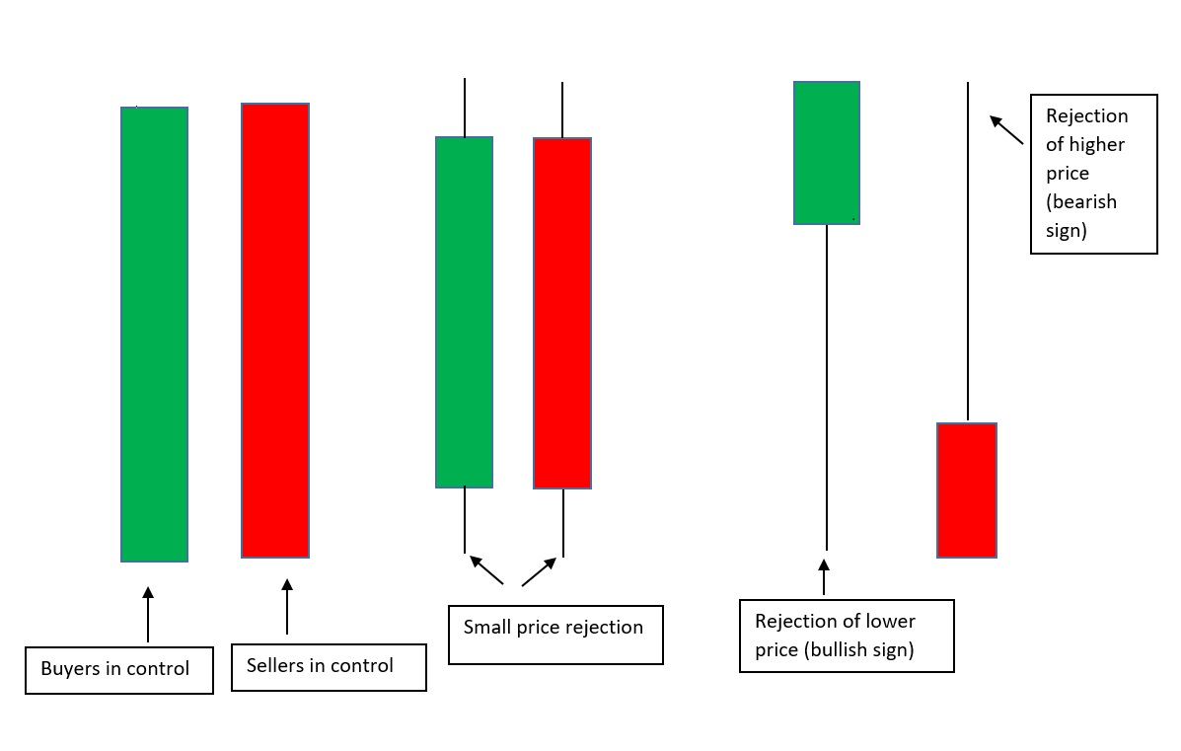
3 Important candle sticks in Day Trading

Slide 18
How to prepare yourself and your chart before market open
Preparing yourself:
1)Watch US Market close previous night 2)Watch Asian markets 3)Watch SGX Nifty (up/down? by how many points?)
(Ref.moneycontrol.com)
Preparing your chart:
5 Min. chart more ideal for Day Trading .
1)Mark previous day high/low, previous day swings/turning points on current day (Refer 5 min TF)
2)Mark if any remarkable selling/buying zone from previous few sessions(Refer 15/30 min TF) and mark if any virgin CPR in past session.
3)Mark important previous swing highs/lows and gaps on daily TF.(Refer Daily TF)
5)If you trade only Index(like me) then better have both Nifty & Bank Nifty in one screen(split screen)
pivotcall.com

Slide 19
Important levels on your chart for Day Trading
Previous Day High(PDH)
Previous Day Low(PDL)
Previous Day turning point/swing point
Days High(DH)
Days Low(DL)
Previous selling zone(Supply zone)
Previous buying zone (Demand zone)
CPR
Virgin CPR
Pivot points-daily/weekly/monthly
(It is high probability set up if 2 pivots(daily/weekly/monthly) at same level/pivot with PDH/PDL with some pivot point at same levels etc)

Slide 20
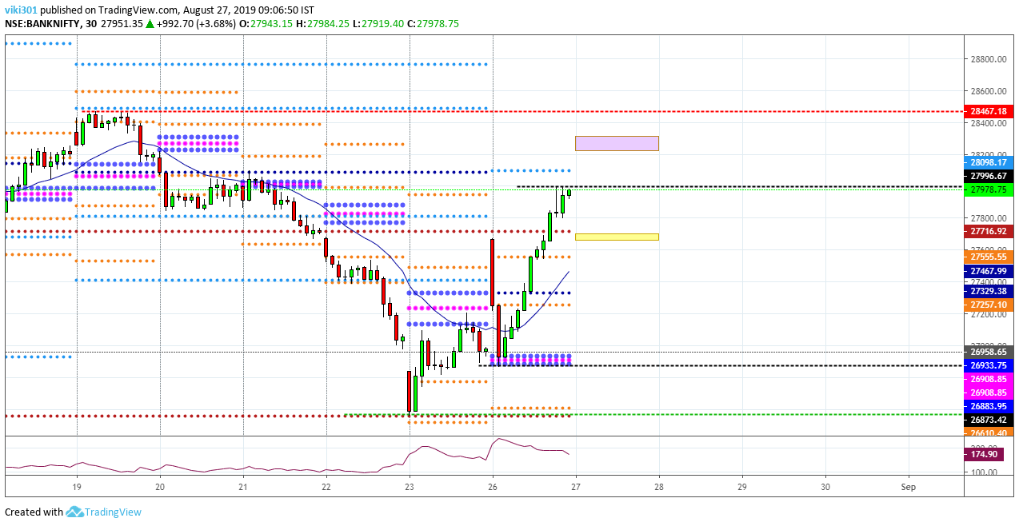
CHART WITH IMPORTANT ZONES MARKED(30 min)

Slide 21
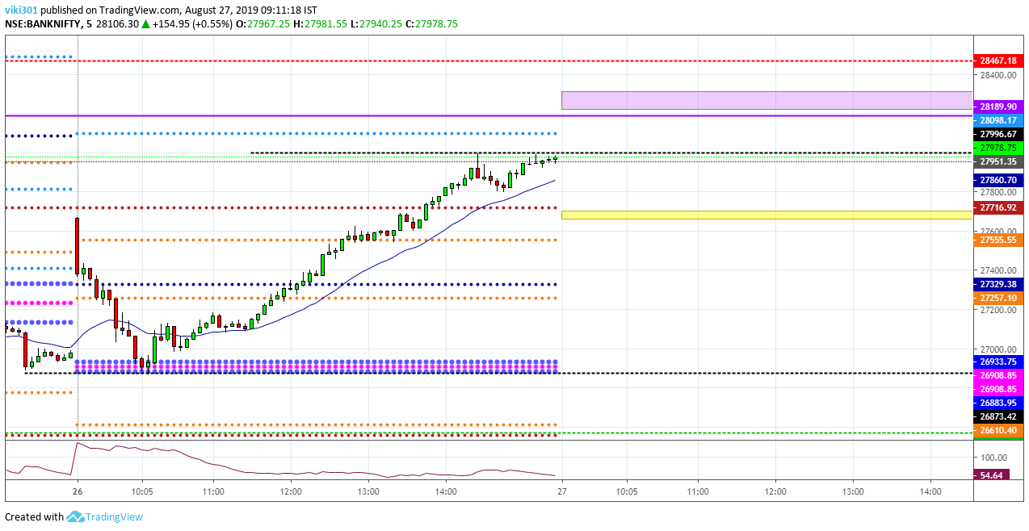
CHART WITH IMPORTANT ZONES MARKED(5 min)

Slide 22
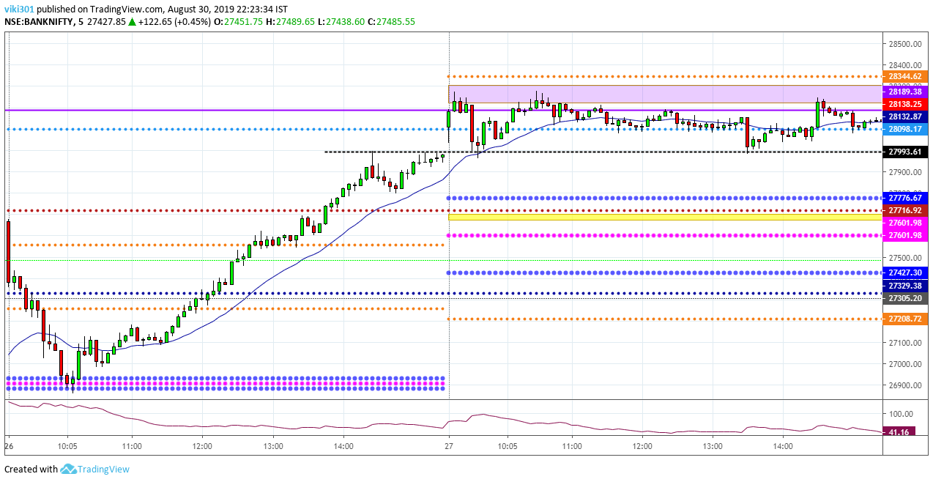

Slide 23
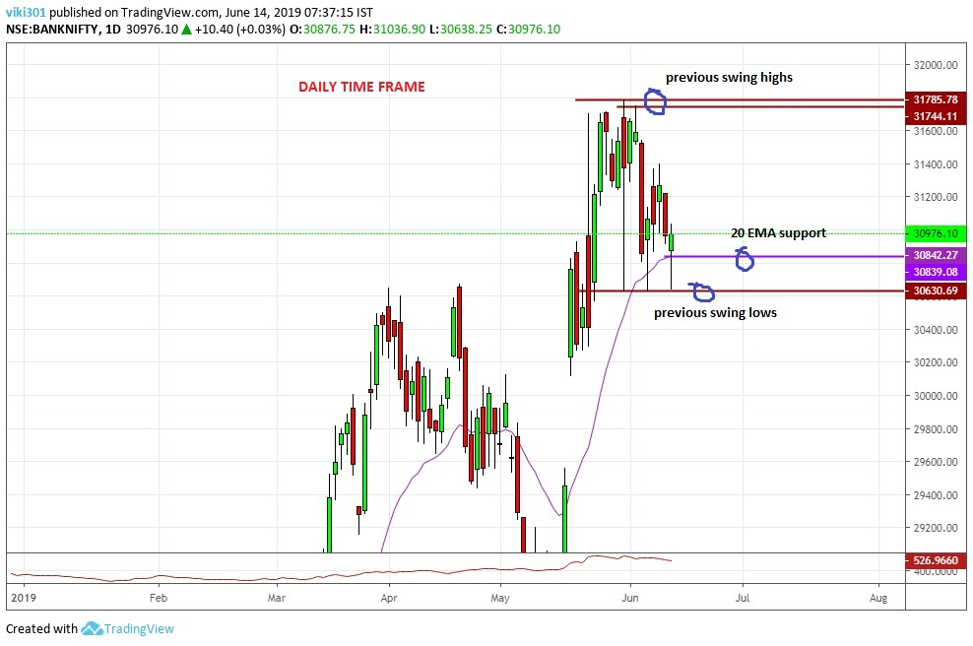
CHART WITH IMPORTANT ZONES MARKED
GAPS

Slide 24
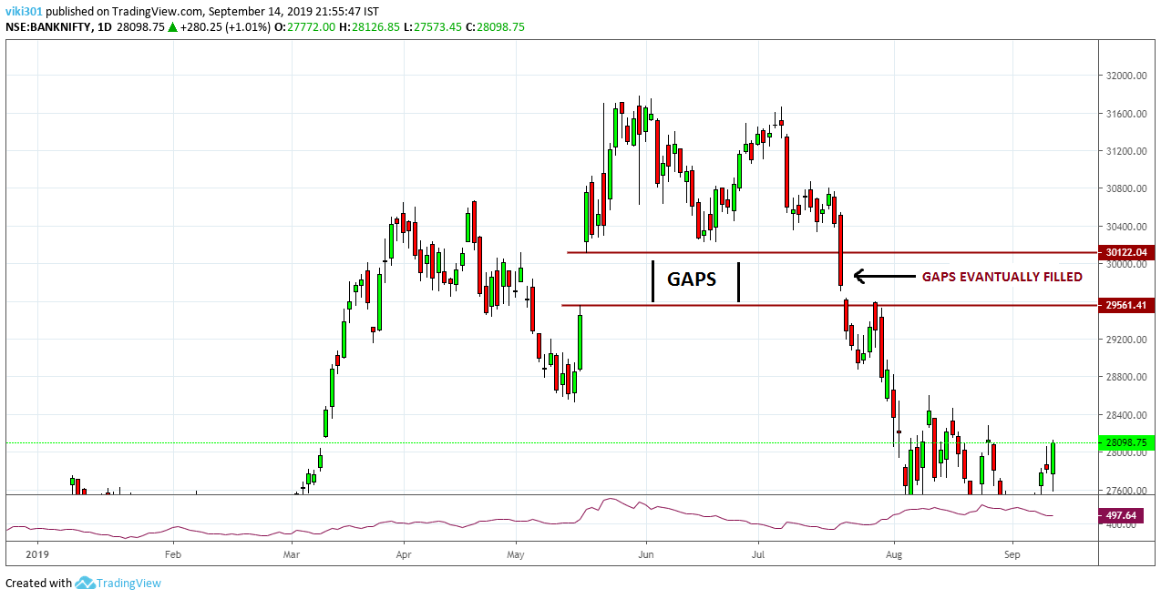
GAPS EVANTUALLY GETS FILLED

Slide 25
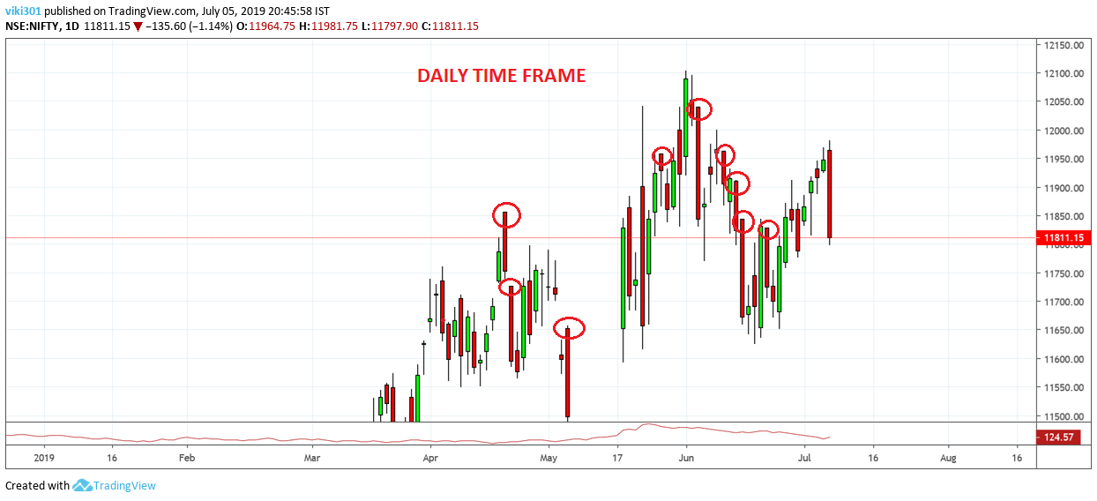
CHART WITH IMPORTANT ZONES MARKED

Slide 26
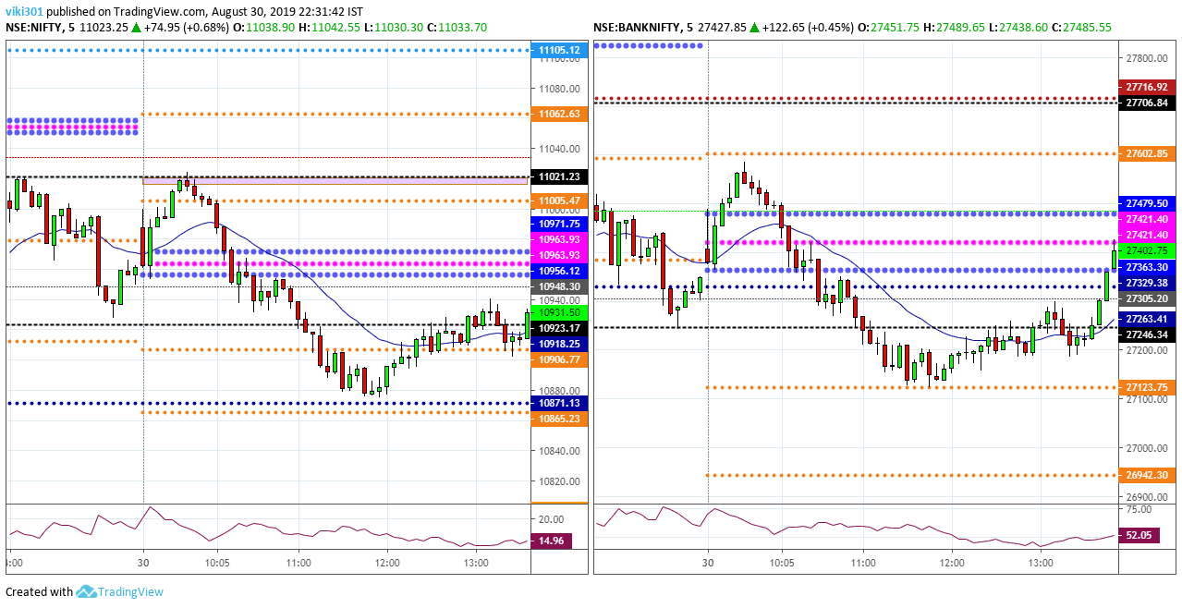
Nifty & Bank Nifty on Split Screen

Slide 27
Using Trading view software for Day Trading
More accurate charting software with nice interface and user friendly.
Lots of options for Pivot Indictors in public library section.
You need 2 Pivot indicators from the public library, Standard Pivots & CPR.
Tradingview has Volume profile indicator for stocks in pro version.
Recommended to use pro version if you are a full time Trader, which provides live data and available at a very reasonable fees per month.
Tradingview also offers 1 month free trail for new users.
pivotcall.com

Slide 28
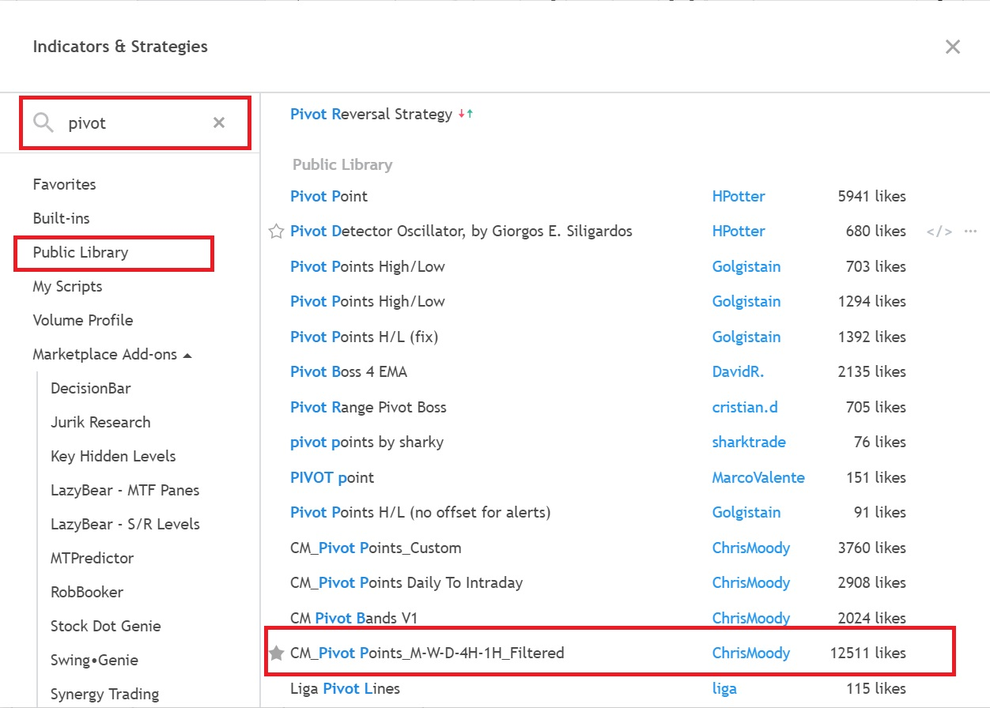
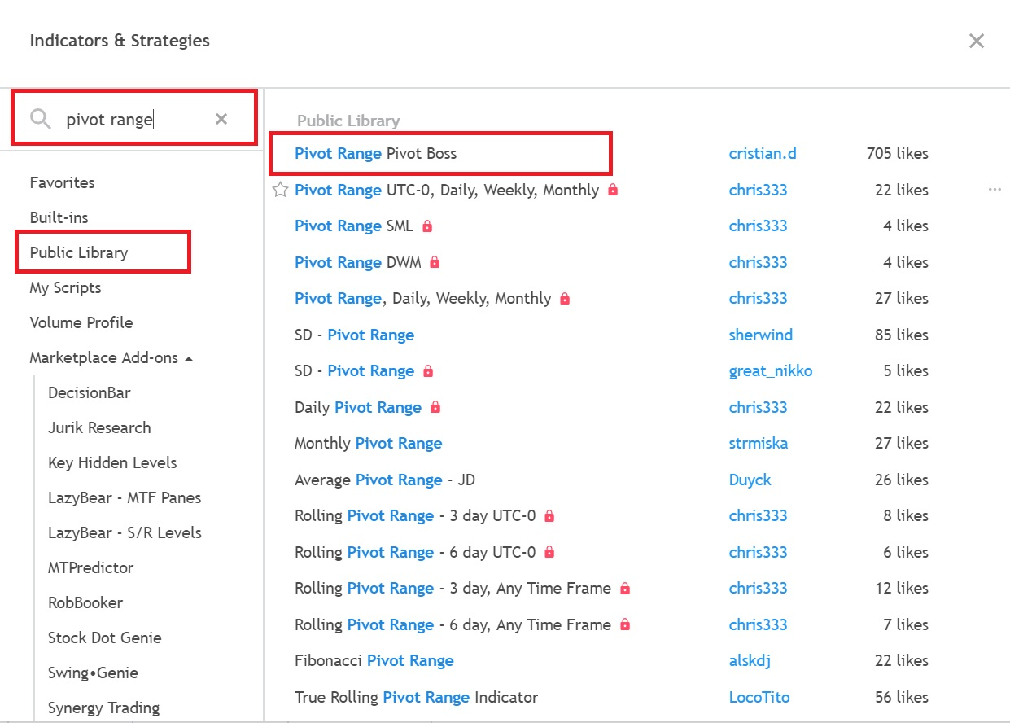

Slide 29
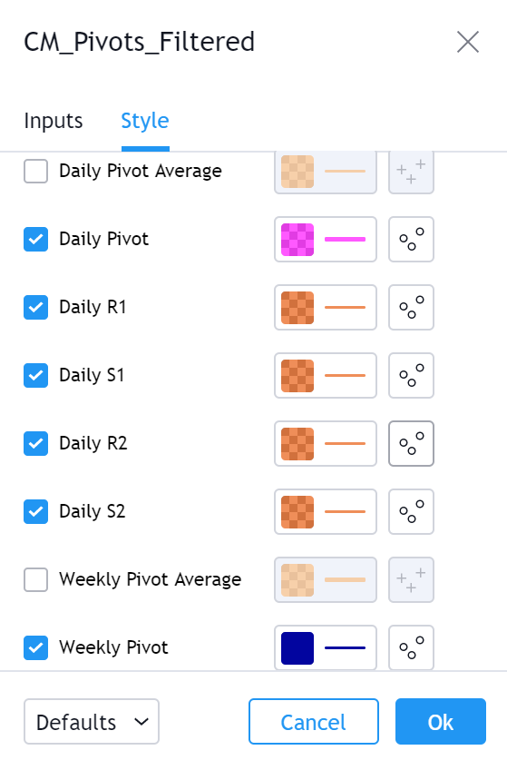
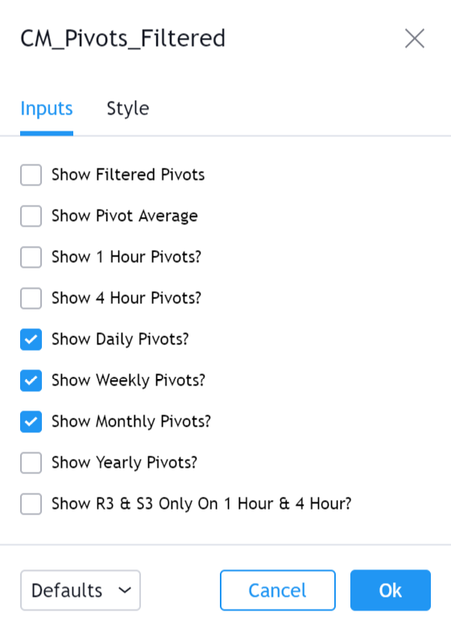

Slide 30
SESSION -2
15 DAY TRADING PATTERNS & STRATEGIES
pivotcall.com

Slide 31
Important points to remember about my 15 day trading patterns
These 15 day trading patterns are not holy grails patterns, just it is high probability patterns (no guarantee that every time it works, so SL is a must)
There are only high probability and low probability set ups, so its best to avoid low probability set ups and trade only high probability set ups with a strict SL.
In Trading, there is nothing like 100% sure shot patterns or 100% sure shot set up, any patterns can fail on any given day, even if it worked in the past, No guarantee that it works every time.
Trading itself is a probability game, not certainty. Trading is not exact science, so SL(Stop Loss) is a must In each and every trade you take.
It is highly recommended to start with a paper trading for few days until you get consistency on trading with these15 day trading patterns.
pivotcall.com

Slide 32
MY 15 DAY TRADING PATTERNS & STRATEGIES
OD (OPEN DRIVE) – (OPENING)
ODR(OD REJECTION)- (OPENING)
PPT(PIVOT PRESSURE TRADE) – (OPENING)
EVENING STAR – (OPENING)
MORNING STAR – (OPENING)
VIRGIN CPR RVRSL – (OPENING)
RCR (RED CANDLE RETRACEMENT) – (OPENING TO MID AFTERNOON)
GCR(GREEN CANDLE RETRACEMENT)- (OPENING TO MID AFTERNOON)
GAP UP REJECTION – (OPENING TO MID AFTERNOON)
CPR BO(CENTRAL PIVOT RANGE BREAKOUT) – (MID TO LATE AFTERNOON)
GAP DOWN REJECTION – (MID TO LATE AFTERNOON)
M RVRSL – (MID TO LATE AFTERNOON)
W RVRSL – (MID TO LATE AFTERNOON)
RCBO (RED CANDLE BREK OUT) – (MID TO LATE AFTERNOON)
GCBO(GREEN CANDLE BREAK OUT)- (MID TO LATE AFTERNOON)
pivotcall.com

Slide 33
SCALPING PATTERNS & BREAKOUT PATTERNS
SCALPING PATTERNS
RCR (RED CANDLE RETRACEMENT)
GCR(GREEN CANDLE RETRACEMENT)
OD (OPEN DRIVE)
M RVRSL
W RVRSL
VIRGIN CPR RVRSL
BREAKOUT PATTERNS
RCBO (RED CANDLE BREK OUT)
GCBO(GREEN CANDLE BREAK OUT)
CPR BO(CENTRAL PIVOT RANGE BREAKOUT)
ODR(OPEN DRIVE REJECTION)
CPR BO(CPR BREAKOUT)
GAP DOWN REJECTION
GAP UP REJECTION
EVENING STAR
MORNING STAR

Slide 34
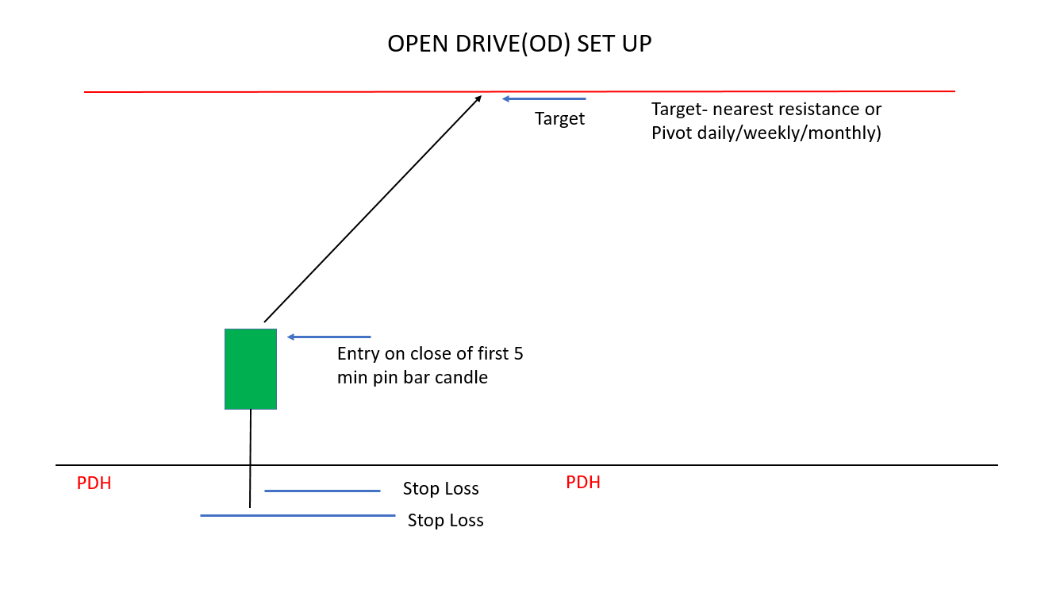
Opening candle should be gap up/gap down candle, or close above PDH or PDL. (Preferably pin bar or bullish candle)
If low of the candle touches PDH/PDL/S1 pivot and leaves a wick below then very high probability trade
Ensure that there is no resistance over head like daily/weekly/monthly pivot or big support/resistance
Target should be 2R or next nearest pivot or keep riding the trend with trailing SL
SL below PDH/ above PDL or below entry candle

Slide 35
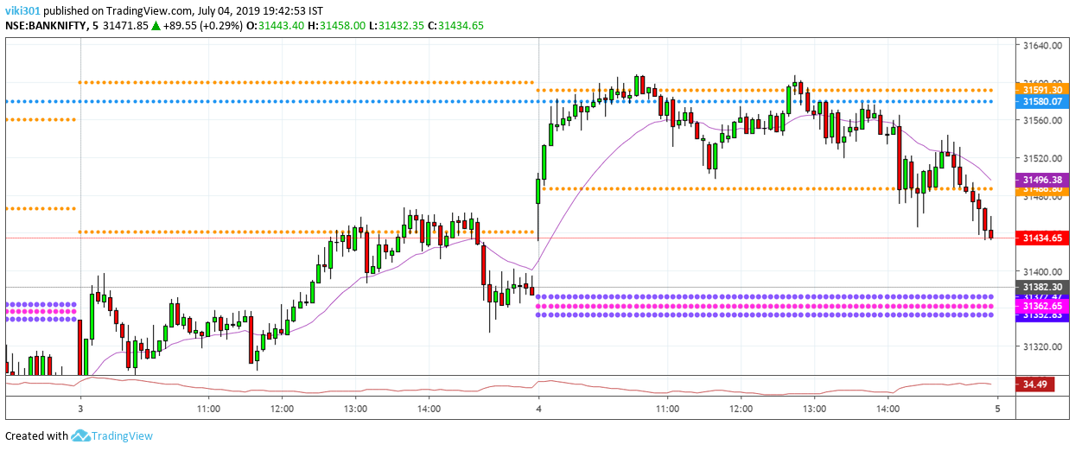

Slide 36
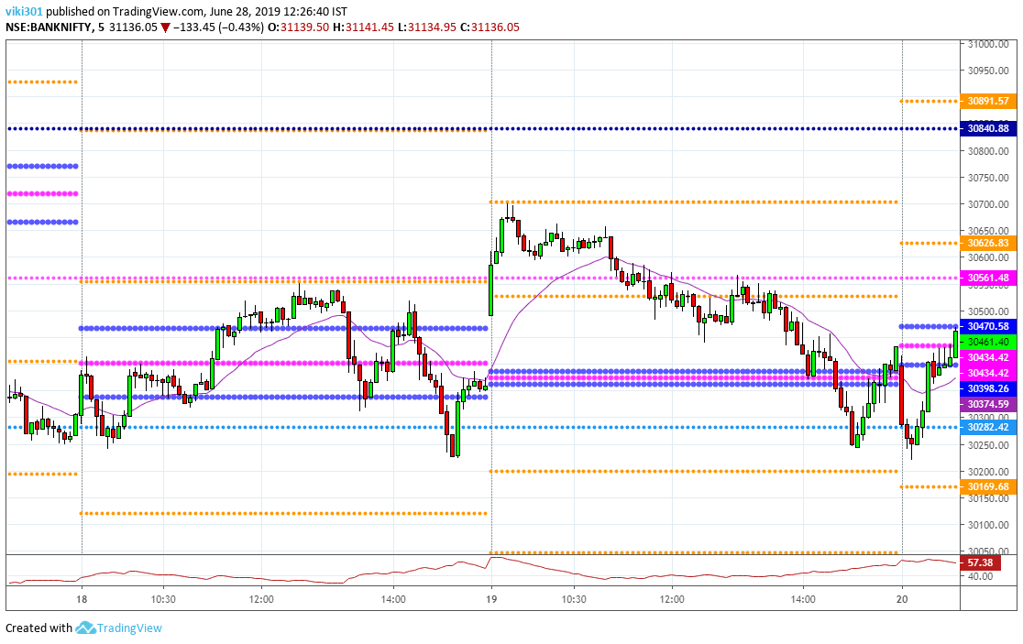

Slide 37
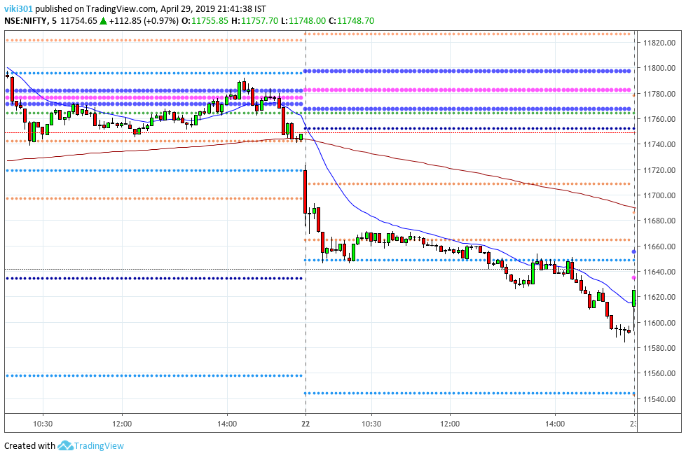

Slide 38
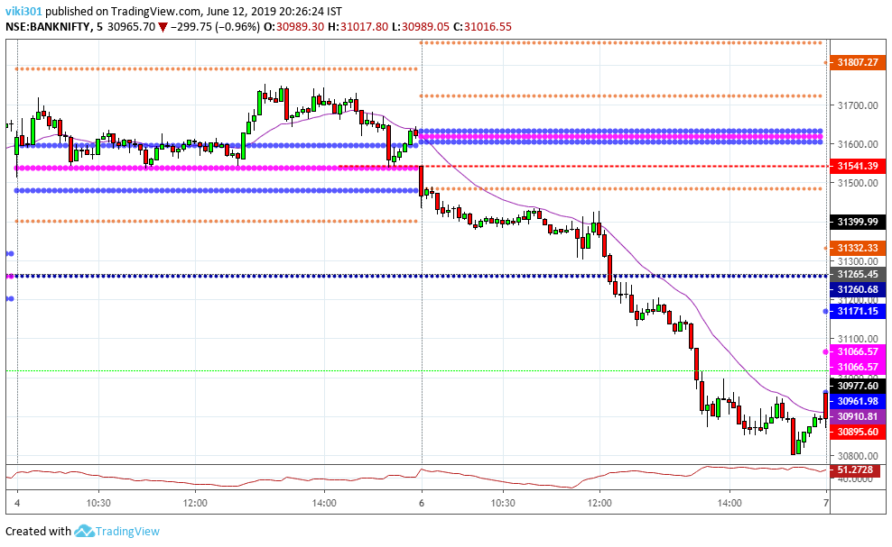

Slide 39
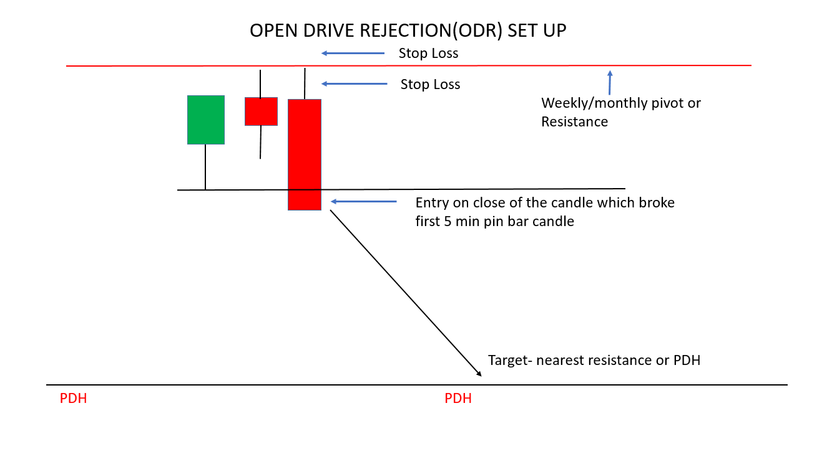
Opening candle should be gap up/gap down candle. (Preferably pin bar or bullish candle)
If close of first candle at some resistance over head like daily/weekly/monthly pivot or swing high/low then expect ODR pattern
Entry on the candle which breaks first candle low .
Target could be 2R or PDH or current day CPR.
SL above entry candle high or above nearest pivot resistance or1R, whichever is lower

Slide 40
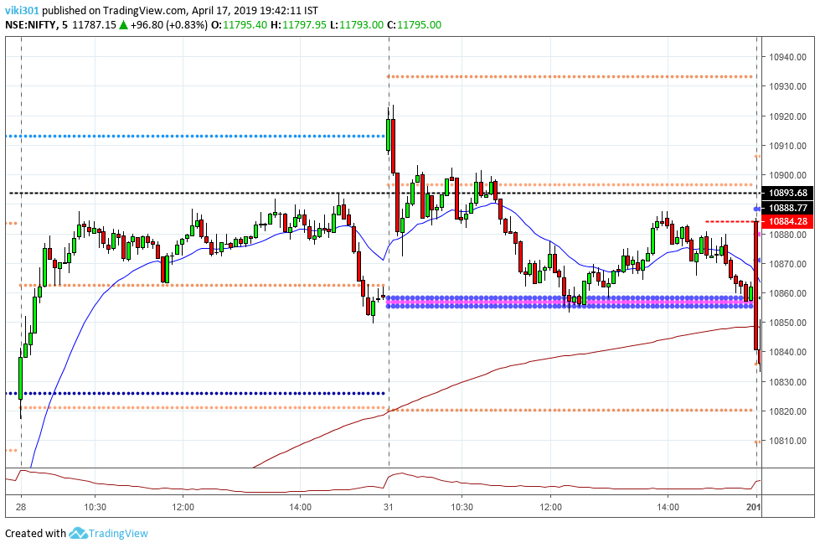

Slide 41
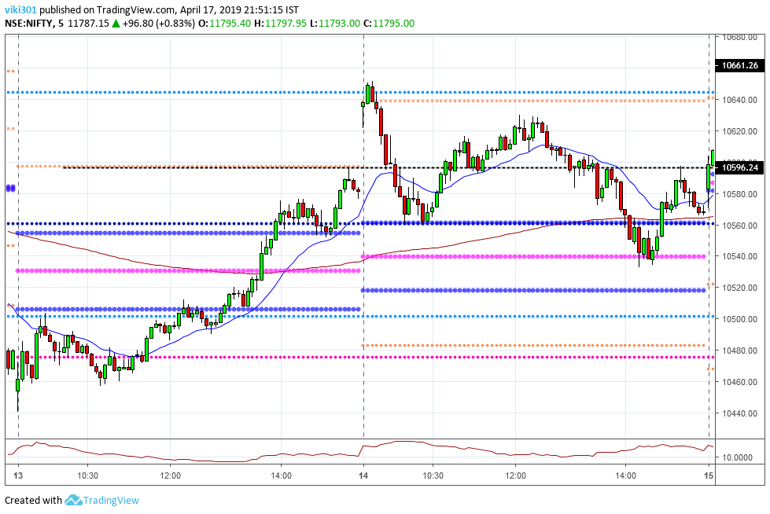

Slide 42
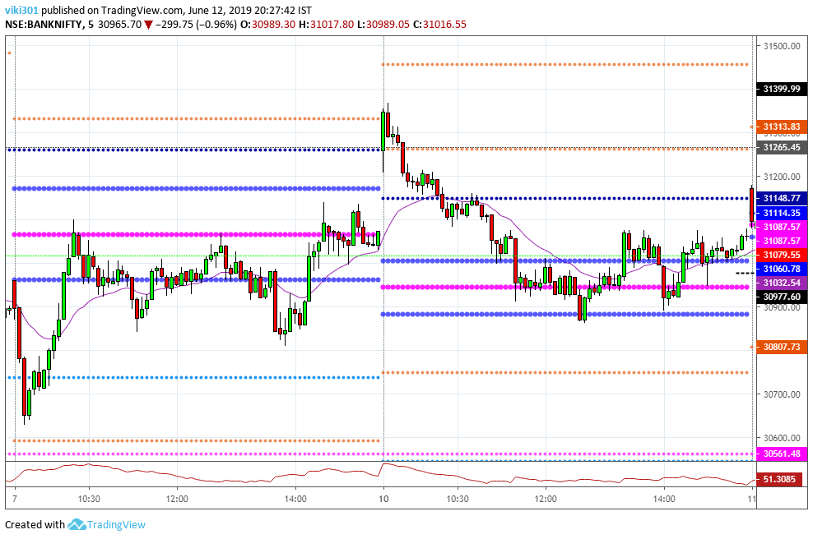

Slide 43
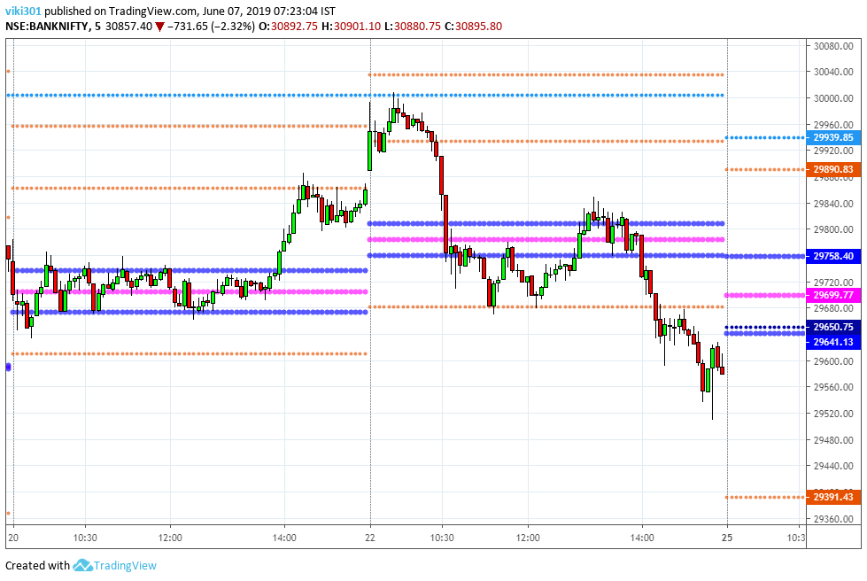

Slide 44
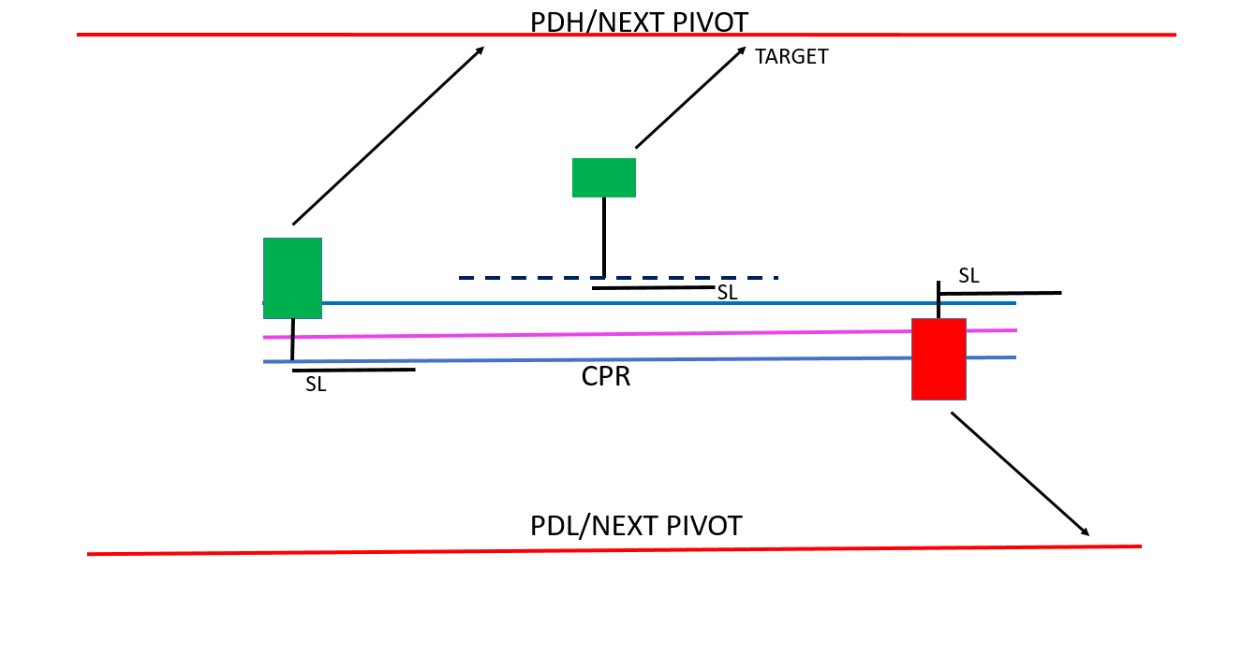
At opening, first candle should engulf CPR and close above it making bullish candle.
Or first candle is bullish pin bar taking support on weekly or monthly pivot near CPR
Target should be near PDH or near next pivot or 2R and SL other side of CPR or below entry candle
pivotcall.com

Slide 45
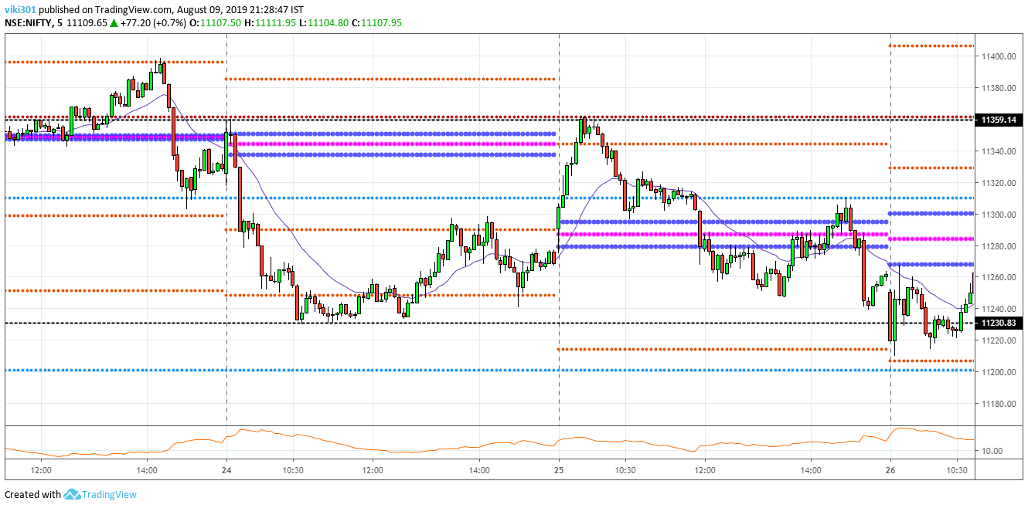

Slide 46
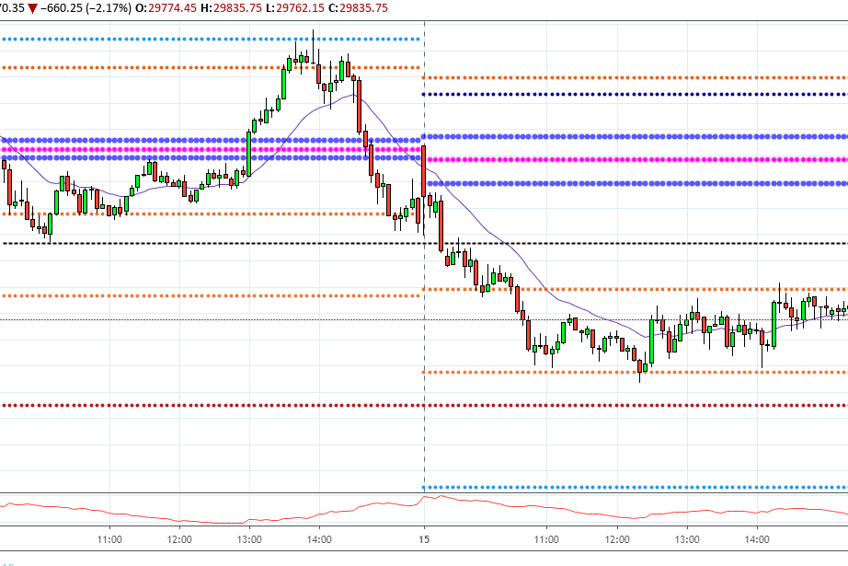

Slide 47
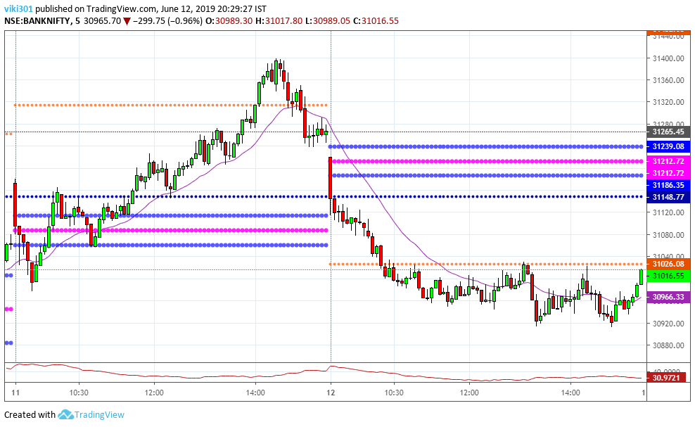

Slide 48
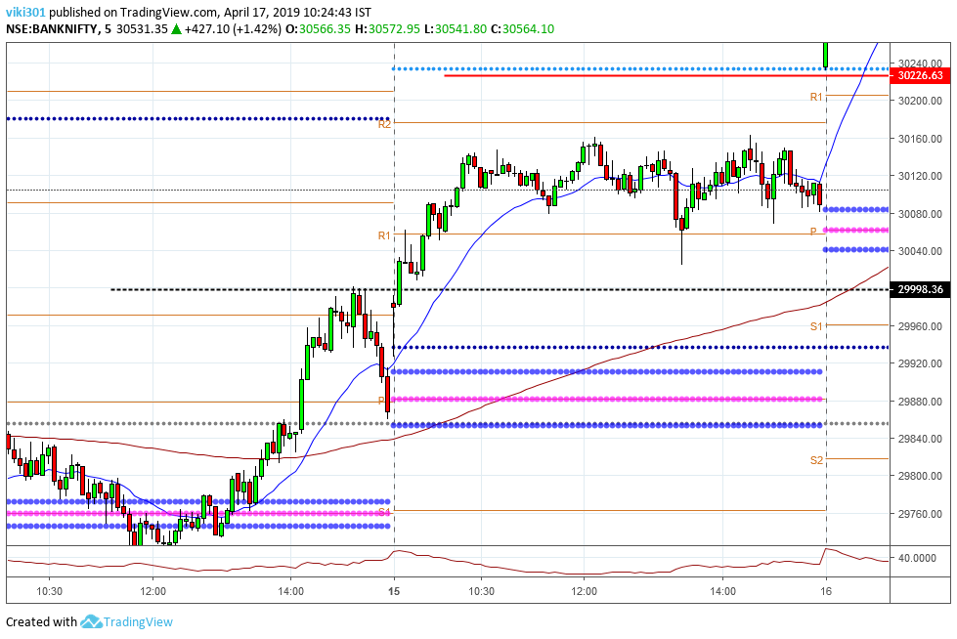

Slide 49
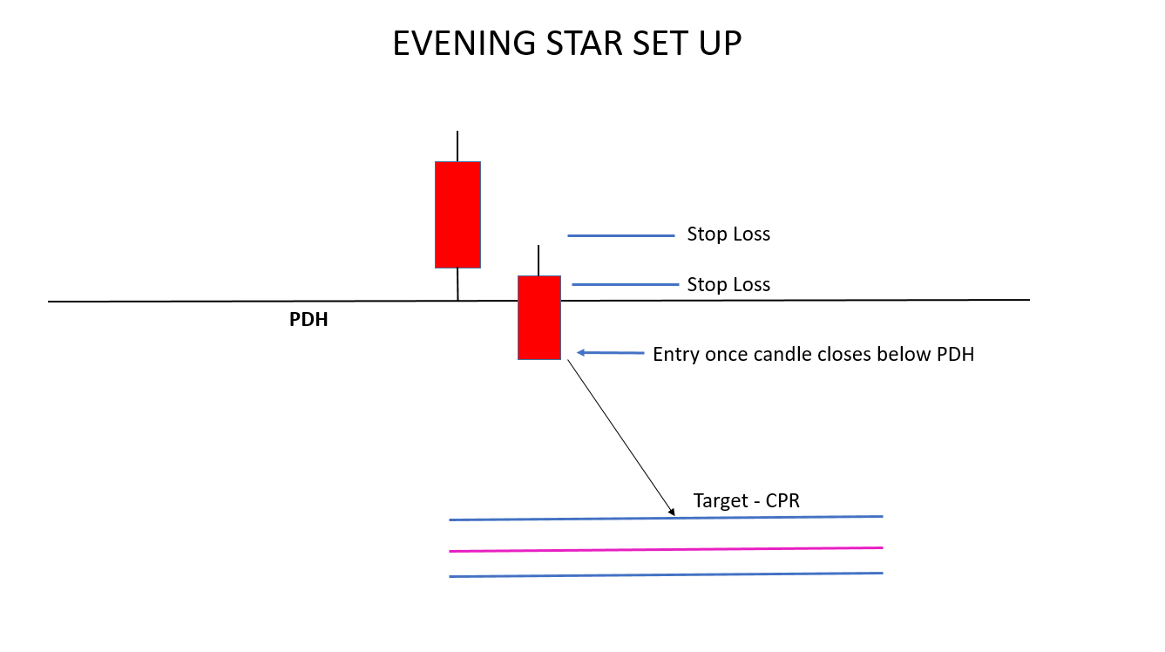
Gap up above PDH, Opening candle should be bearish candle
First candle or next should close within PDH.
SL above PDH or above entry candle or above nearest pivot resistance or 1R.
Target should be CPR or 2R or more
pivotcall.com

Slide 50
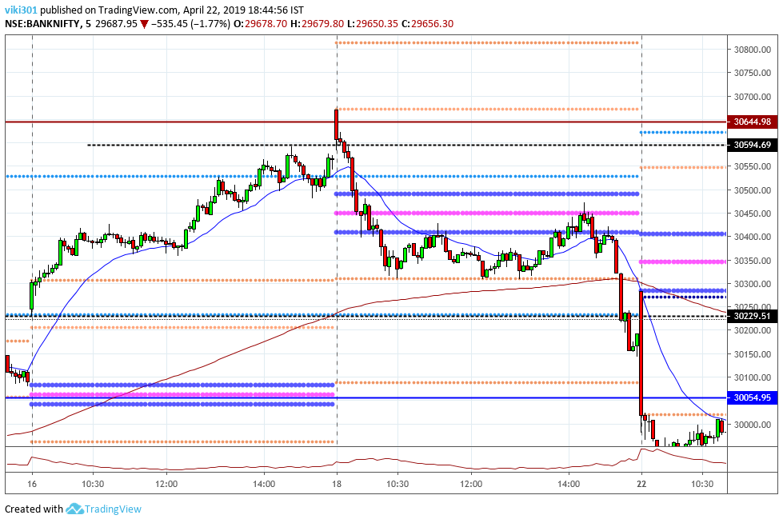

Slide 51
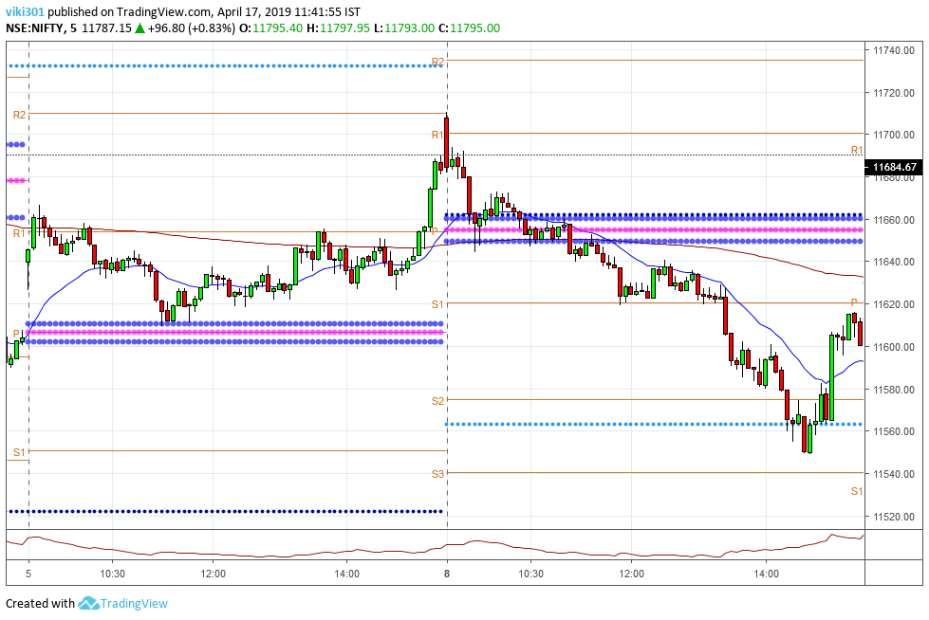

Slide 52
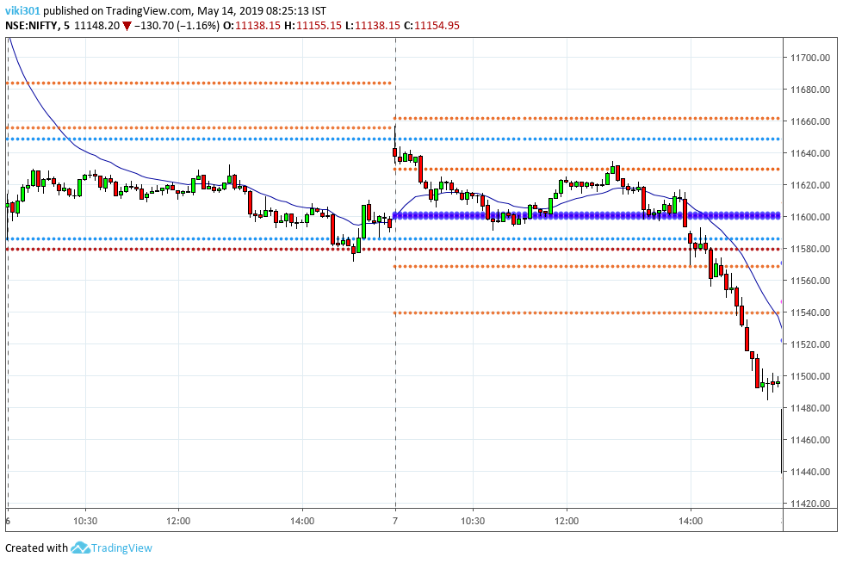

Slide 53
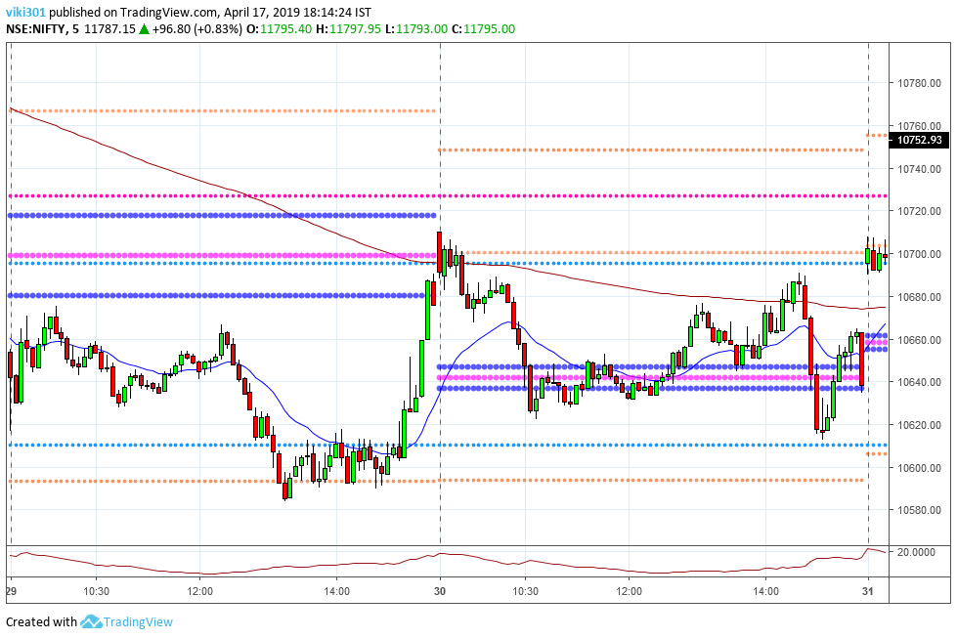

Slide 54
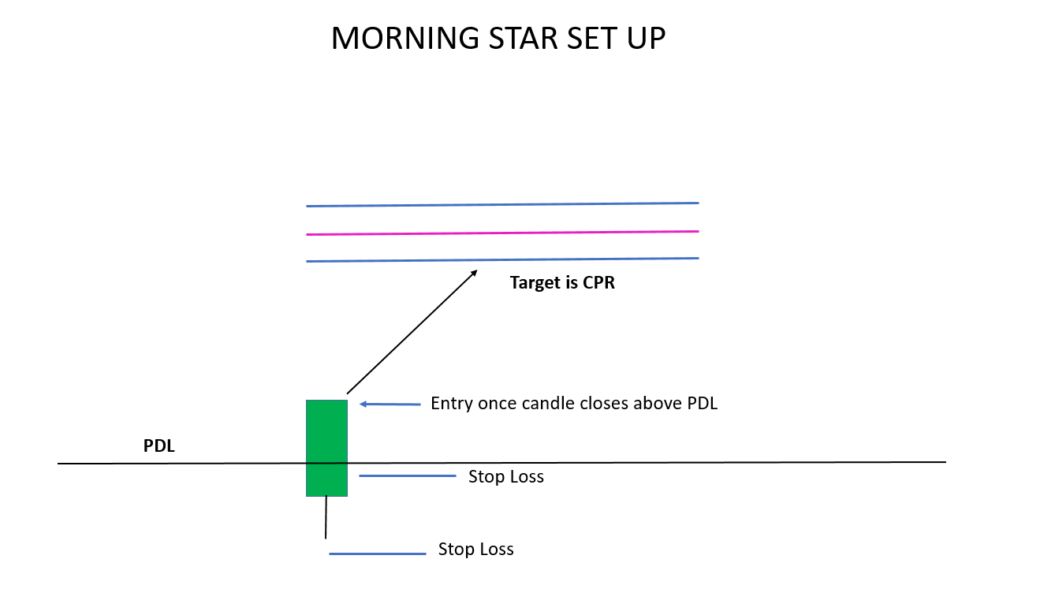
Rule Opening candle should be preferably green pin bar
Opening candle should be gap down candle but first/second candle within yesterdays range
Go long if there is good space to move till CPR, SL below entry candle or 1R.
Target should be CPR or 2R whichever higher.
pivotcall.com

Slide 55
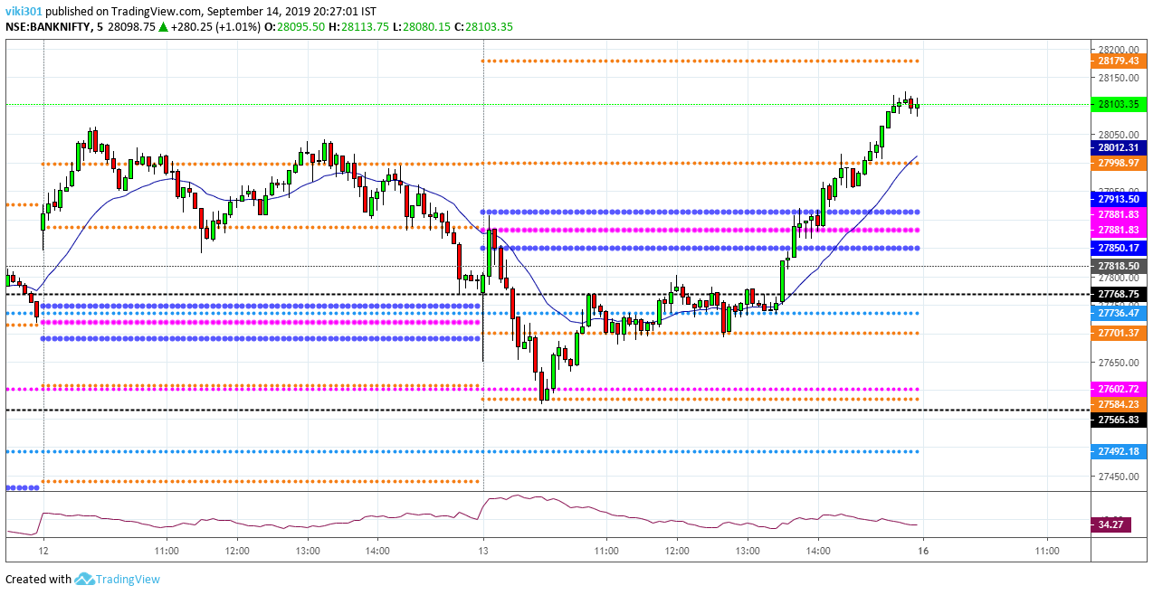

Slide 56
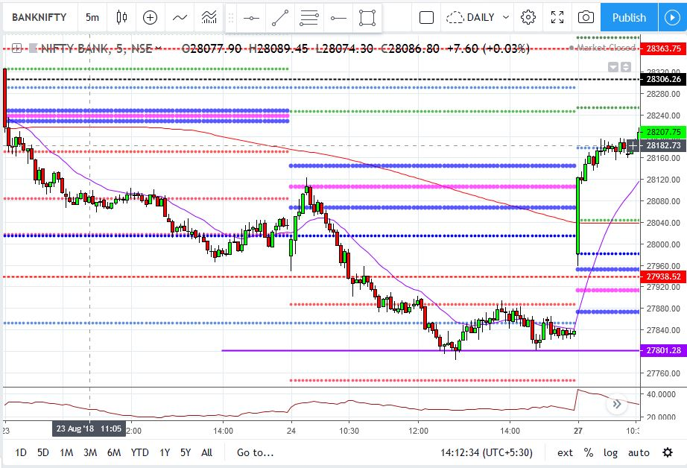

Slide 57
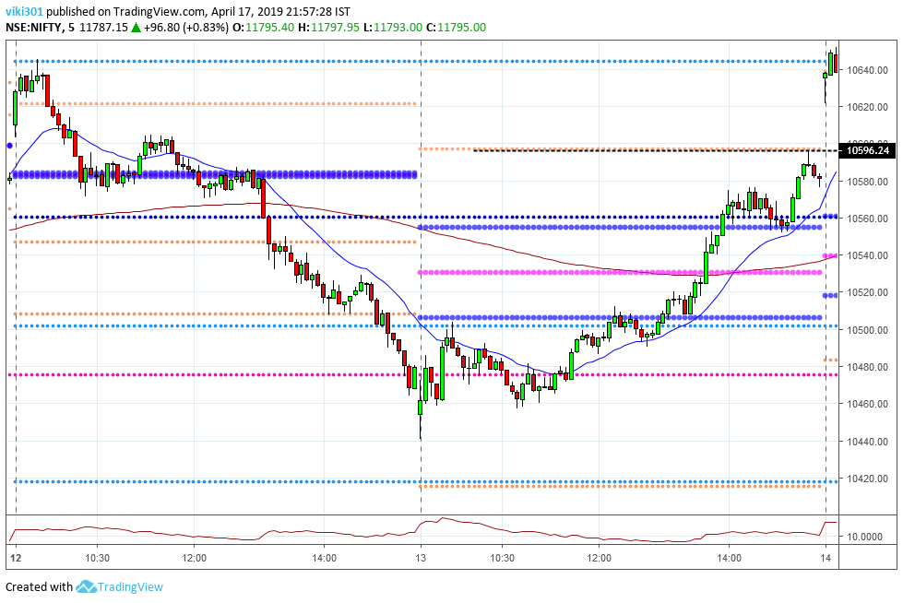

Slide 58
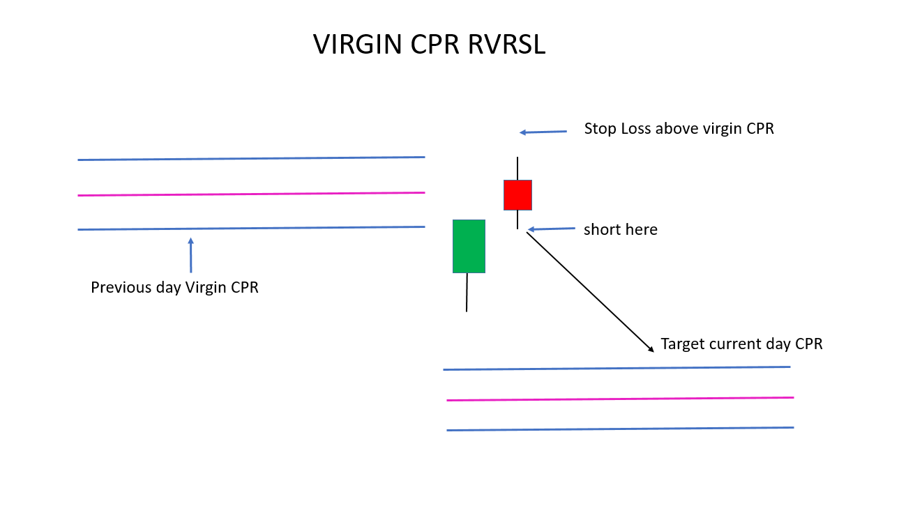
Short if next day price approach VCPR or closes near Virgin CPR at the opening.
Keep SL just above UCPR or 1R, Target 2R or current day CPR whichever higher.
Works well at opening or till mid afternoon only
pivotcall.com

Slide 59
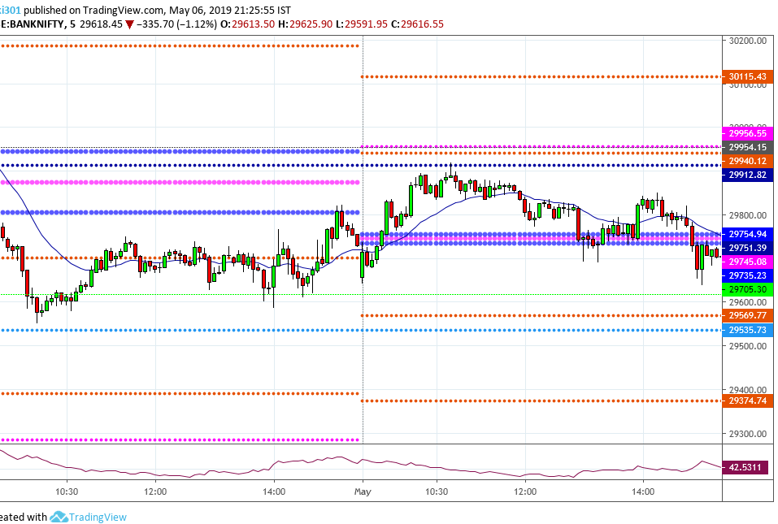

Slide 60
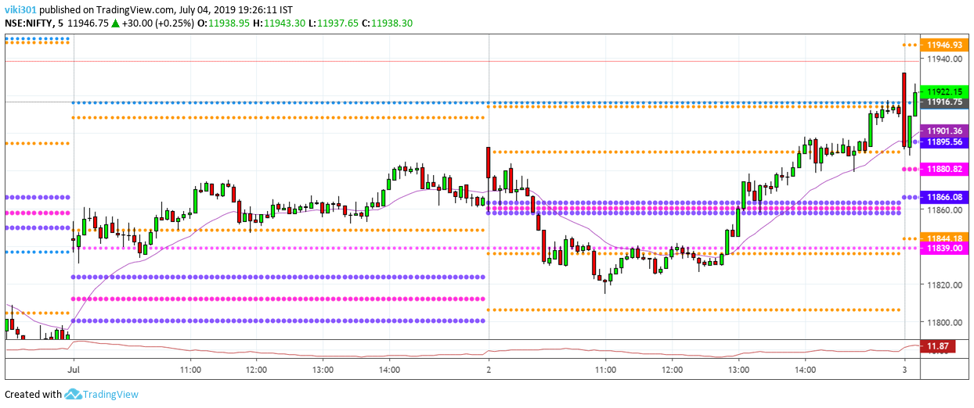

Slide 61
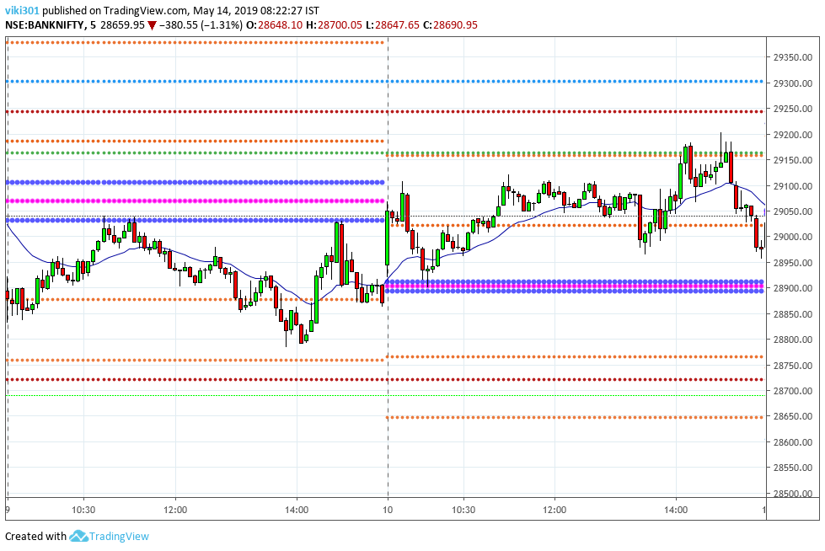

Slide 62
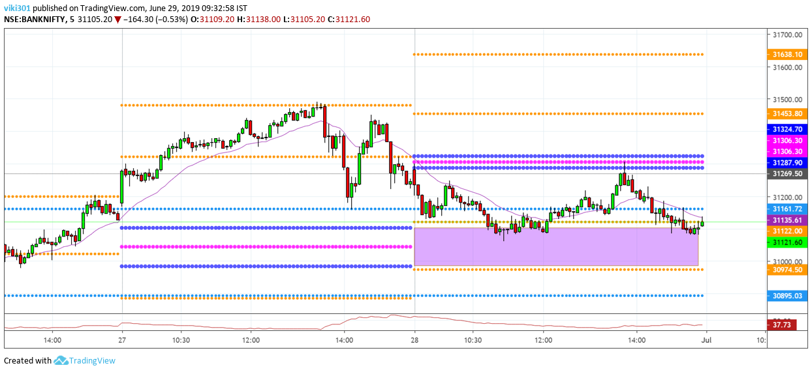

Slide 63

First 5 min candle(opening candle) should be medium to big red candle
Take Short trade when price retraces back to high of the first 5 min. candle
High probability trade, if retracement happens in first one-two hour, and high of the candle and CPR at same place.
SL (stop loss) should be 1R or above the CPR, whichever is lower. TGT is 2R or below first candle.
pivotcall.com

Slide 64


Slide 65


Slide 66


Slide 67


Slide 68

First 5 min candle(opening candle) should be mid to big green candle or bullish pin bar candle.
Take long trade when price retraces back to low of the first 5 min. candle(take only first retracement)
High probability trade, if retracement happens in first one -two hours.
SL (stop loss) should be 1R or below next support or pivot... TGT is 2R or more.
pivotcall.com

Slide 69


Slide 70


Slide 71


Slide 72


Slide 73

It is a GAP FILL CONCEPT, Market should open huge gap up, First candle should be bearish candle or reversal pin bar with its high touching at some pivot or some big resistance
SL 1% from entry price or above entry candle or above the pivot/resistance
Target –PDH or 2R

Slide 74


Slide 75


Slide 76


Slide 77


Slide 78

DIFFERENCE BETWEEN OPEN DRIVE VS GAP UP REJ VS EVENING STAR

Slide 79

Rule Market should make a consolidation around CPR.
Once it breaks out of CPR with full body candle, (go long if breakout happens
at UCPR and go short if breakout at BCPR), High probability trade if it happens in late afternoon.
Target – 2R or more.SL above other side of CPR or breakout candle or 1R
pivotcall.com

Slide 80


Slide 81


Slide 82


Slide 84

Rule Previous day(or day before) should be bearish day or close at low of the day.
Current day should be big gap down.
Watch price action near PDL, If it breaks go long( late afternoon is high probability)
Expect a big move after breakout. Target 2R or more.
SL 1% from entry price or below PDL or below breakout candle.
pivotcall.com

Slide 85


Slide 86


Slide 87


Slide 88


Slide 89

Day structure Should be Trading range day
Price should retrace back or near or below low of the day after making high in the first one hour.
Go short when price comes back to high of first one hour(DON’T BE CONFUSED M PATTERN with RETRACEMNT)
SL 1% from high of first one hour or above nearest pivot resistance.
Target 2R or previous swing low.
pivotcall.com

Slide 91


Slide 92


Slide 93


Slide 94

Rule Just opposite of M reversal
Day structure Should be Trading range day.
Price should retrace back to low of the day after making high in the first one hour
Go long when price comes back to low of first one hour
SL 1% from entry or below nearest pivot support and Target 2R or previous swing high
pivotcall.com

Slide 95


Slide 96


Slide 97


Slide 99

First 5 min candle(opening candle) should be big red candle
Take long trade if price breaks out high of the first 5 min. candle, RED candle can be from previous day also which was not broken.
High probability trade, if breakout happens in opening(for previous day RED candle) or late afternoons(for current day candle)
SL (stop loss) should be 1R or below breakout candle, whichever is lower. TGT is 2R or more.
pivotcall.com

Slide 100


Slide 101


Slide 102


Slide 103


Slide 104

First 5 min candle(opening candle) should be big green candle/or bullish pin bar
Take short trade if price breaks low of the first 5 min. green candle.
High probability trade, if it happens in mid to late after noon.
SL (stop loss) should be 1R or above the breakout candle, whichever is lower. TGT is 2R or more.
pivotcall.com

Slide 105


Slide 106


Slide 107


Slide 108


Slide 109
My SL(stop loss) method in day trading
BERFORE ENTERING A TRADE “ALWAYS ASK YOURSELF WHAT’S MY STOP(SL)”
5 Methods
a)ATR Method - SL based on ATR, use this method based on current ATR plus some buffer(read in the chart in next slide for clear explanation)
(most suitable in mid afternoon when volatility is less and for ATM option trades)
b)Placing SL below or above important pivots like weekly/Monthly pivots(If there are cluster of pivots or support/resistance then place your SL below/above last support/resistance)
c) Placing above or below PDH, PDL(Works effectively at opening, less effective in afternoon).
d)Placing above or below CPR(only if CPR is average and not very wide) if CPR is very wide then SL above or below entry candle.
e) Placing below or above 20 EMA, only if it is in trending mode.
(if 20 EMA confluence with daily or other pivot then SL can be below that pivot)
pivotcall.com

Slide 110

ATR Method

Slide 111

Placing SL below/above important pivots like weekly/Monthly pivots

Slide 112

Placing above or below PDH, PDL

Slide 113

Placing SL above or below CPR

Slide 114

Placing below or above 20 EMA only if it is in trending mode(up or down)

Slide 115
Secrets of using moving averages in Day Trading
Most important moving averages
8EMA,20 EMA (on smaller time frame like 5 min)
8 EMA- Only for following the trend after breakout, in late afternoon breakouts, helps in riding the winner
20 EMA – For entering the trend when there is a strong momentum on one side.
20 EMA on larger time frame like daily chart(I don’t use 8 or 200 EMA on daily time frame)
According to me 20 EMA most important EMA on larger time frame.
Most of the time if market is in up trend or downtrend and when it comes and touches 20 EMA on daily time frame, large moves or big bounce takes place in Intraday(Most often)
As per my experience 20 EMA is most powerful compared to any EMA on larger timeframe.
pivotcall.com

Slide 116

Moving averages in Day Trading (8EMA on 5 min)

Slide 117

Moving averages in Day Trading (8EMA on 5 min)

Slide 118

Moving averages in Day Trading (20 EMA on 5 min)

Slide 119

Moving averages in Day Trading (20 EMA on 5 min)

Slide 120

Moving averages in Day Trading (20 EMA on daily)

Slide 121
How do I select option strike
Buying VS Selling options.
On any day, I prefer selling options rather than buying options.
By selling options, I make money even price is not moving in my direction and stays at same place, 2 ways to earn money in option selling, compared to one way in option buying.
I buy options when I expect price to fall heavily or breakout trades(mostly in late afternoon trades)
Selecting Option strikes
On regular days, I sell options 1-2 strikes away in Nifty or Bank Nifty for selling options(most of the time)
While buying options, I buy ATM or slightly OTM(most often)
For selling options, its always OTM options, neither ATM or ITM(most often)
(My selection of strike price also depends on volatility and option premium prices, so selecting option strike sometime varies then what mentioned above)
pivotcall.com

Slide 122

ONLINE QUIZ-GUESS THE PATTERN

Slide 124


Slide 125


Slide 126


Slide 127


Slide 128
SESSION -3
Risk management & Position Sizing

Slide 129

Importance of Risk Reward in Trading
One of the most famous book ever written on Trading.
This book contains Interviews with top traders of the world.
Every Trader has different strategies, there is no magic strategy or magic indicator, only reason they are successful because of good understanding of Risk Management and discipline in trading.
Risk Management is as equally important as having a winning strategy.

Slide 130
Importance of Risk Reward in Trading
Risk Management is probably only ”holy grail” when it comes to trading.
One can be a profitable trader even with a win rate of 50%(1:2 RR), 40%(1:3 RR) or just 30%(1:3RR) (only if you are very good at letting winners run and cutting losers short)
Many traders lose in trading because of lack of understanding of risk management…
Position sizing is part of risk management, one should know ho many lots/shares one should take for each trade.
pivotcall.com

Slide 131
Position Sizing in Trading
Position sizing is knowing how many shares/lots you have to buy before taking a trade.
How to calculate position sizing?
a)Calculate your total trading capital first
b)Determine your risk per trade (1-2%)
(Risk is maximum you will lose of your SL hits)
Example,
Capital = 5 lakhs, Risk per trade (1%) = 5k, maximum loss= 5k (if SL hits)
It should be 5k in every trade.
pivotcall.com

Slide 132
Position Sizing in Trading
Formula for right position sizing,
% Risk per trade x Capital
Risk per trade(SL)
Suppose Bank nifty at 30200, and you want to go long and want to buy CALLS(30200 call premium at Rs 200)
Entry = 200
SL = 175 (25 points risk)
Target = 250 (50 points reward)
(R:R = 1:2)
Formula
1% X 5,00,000 = 5000 = You have to buy 200 units (10 lots of BN)
25 25
pivotcall.com

Slide 133
5 Rules of Risk Management
1)The 1% Rule
(Risk no more than 1% of your capital in each trade, 2% if you are an experienced trader)
2)Have a SL(stop loss) in each and every trade(should be in the system, not a mental stop loss)
(maximum SL, 1% of your capital)
3)Have a Strict Risk Reward ratio of around 1:2 per trade.
(If risk reward is 1:2 and your win at least 50% of the time, you are guaranteed to be a profitable trader)
4)Never average to your losing position.
(Never add to your losing position hoping that it will turn around)
5)Have a daily limit loss of say max. 2% of your total capital.
(Have a daily limit on your losses, if risk is 1% per trade, if you took 2 trades and both hits your SL, you are done for the day, no more trades for the day)
pivotcall.com

Slide 134
Preparing and maintaining Trading Journal
A trading journal is a complete record of all your trading activity over time. It consists of 2 things, first, writing down the results of all your trades, second, saving the chart with your entry/exit marked on it.
Record-keeping is the key to success in every profession or skill; if you want to improve, you have to record your trades.
Without having a Trading journal you will never be able to analyze it and remember why you took that trade, unless you have maintained records of all trades.
Trading journal is the one which differentiates Professional traders from amateurs.
And most importantly, it will make you a very systematic trader and once started, you will enjoy doing it.
pivotcall.com

Slide 135
SESSION -4
TRADING PSYCHOLOGY

Slide 136
Why Trading Psychology most important in Trading
Successful Trading comprises of 3 parts, in that 50% of Trading success comes from Trading Psychology, not strategy.
Successful traders are not successful because of some secret strategy or secret indicator but because of right mindset.
Many new Traders constantly search for “Holy grail strategy” that can give winning trades all the time, does it Exist??......NO
The secret to successful Trading does not lie in Amazing strategy or indicator…The secret lies in traders Mind.
pivotcall.com

Slide 137
Powerful ways to control emotion during Trading
Having strict Discipline
Trade according to entry/exit rules, never on your emotions…
Focus on following the rules, not on outcome of the trade…
Avoid……
Revenge Trading - (Exit once SL hits, don’t keep fighting with market)
FOMO(Fear of Missing Out)- (if you miss one, another one will come)
Over Trading- (Have strict rule of 2-3 Traders per day)
Think logically
Trading is probability game, any strategy can have loosing streak(4-5 or more) or winning
streak(4-5 or more)
Have discipline to Stick to your strategy through the wins/losses.
As long as you have 50% win rate, with average win is more than your average loss, you will
stay profitable over log run.

Slide 138
Powerful ways to control emotion during Trading
Have confidence
Having confidence doesn’t mean having confidence to take big trades, but having
confidence in your strategy.
Stick to one strategy and master it, don’t jump from one strategy to another strategy.
Self Analysis
Do a self analysis on your personality – Ask yourself what’s your weakness ? Are you an impatient
person? Are you a short tempered? Are you Egoistic person? Are you Revengeful?
If answer is YES to anyone of them then work on it, because your personality reflects in your trading.
Patience
Wait patiently for right set up, only trade when there is high probability set up/pattern.
When you are in doubt, do nothing, don’t trade.
Day trader doesn’t mean one has to be constantly trading the entire day. Taking 10 -15 trades….
1-2 good trades per day enough to stay profitable month after month.

Slide 139
Top reasons behind my Trading success
1) I am not in Trading business because of easy money or its giving me financial freedom, but I have real passion for Trading and passionate about chart analysis.
2) I have no Financial liabilities – No big EMIs to pay/Not depending on my trading profit to run the house, I am in NO pressure to make profit every day by trading.
3)I trade only 2 instruments(Nifty &Bank Nifty) day in and day out, that’s giving me a great edge and helps me in understanding its movement on daily basis.
4)I have more than Five hundreds of EOD (end of the day)charts saved in my computer, which I analyze on regular basis, and that helped me in mastering chart reading.
5) I have set strict rules in my trading, like not more than 2 trades per day, and max. loss -2R per day.
6) I treat Day Trading as a serious business, I treat my SL like cost of doing my business.
7) I have realized that to become better trader, one has to be better human being first, so I worked on my shortcomings which reflected in my trading performance.
pivotcall.com

Slide 140
THANK YOU

